Slide 1
National History Day Exhibit

Slide 2
Make Your Thesis Stand Out
It’s the most important “thing” on your exhibit.
• Your thesis must be clear on your exhibit itself.
• You don’t need to label it as “thesis.”
• Instead use the font size, placement, and design elements to help it stand out.

Slide 3
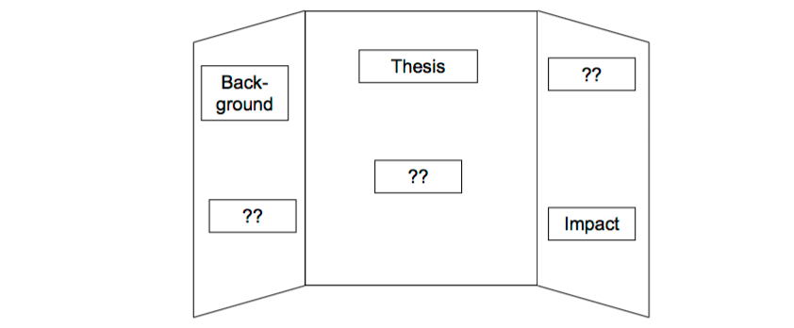
How To Organize It?
Identify the sections you need.
Each section should be directly connected to supporting your thesis.
Organize those sections in a logical way.

Slide 4
Identifying Supporting Material
What images, illustrations, documents, or other media can you incorporate?
• Each item should have a DIRECT connection to the argument you are making.
• Narrow it down! You will likely have found much more than you can put on your exhibit.

Slide 6
Writing Interpretive Captions
Brief citations tell the viewer where you found the image/illustration.
“Photo from Wisconsin Historical Society”
These do NOT count towards your word limit.
Interpretive captions analyze the supporting material.
They’re important to show why the image/illustration is there. What does it mean?
These DO count towards your word limit.

Slide 8
Choose Your Colors
The right color choice sets the tone for your project.
The wrong colors can be confusing or even be offensive.
Which colors would you use for an exhibit about the American Revolution? The Green Bay Packers? The women’s suffrage movement in the United States?

Slide 9
Find Your Fonts
Fonts can be creative, but they should still be easy to read.
Save the fancy font for titles and section headers.
Use a more common font - Ariel, Times New Roman - for the main text.
Be sure to use a font size is large enough to read from about 2-3 feet away. That’s how far away your judges will stand from the exhibit.

Slide 11
Interactive Elements
Use interactive elements to engage viewers with your exhibit.
They don’t have to be complicated or use lots of technology.
They must be DIRECTLY connected to your topic and RELEVANT in proving your argument.
Don’t forget you can use the space in front of your exhibit, on the table.

Slide 13
Title Matters
Make it snazzy... but also make sure it describes your topic.
“Susan B. Anthony: or... “Votes for Women: Susan B. Anthony and the Fight for Suffrage”
“Agriculture in the 20th Century” or “Adapt or Die: The Impact of Revolutionary Changes in Agriculture in the 20th Century”
“Louis Pasteur” or “Pasteurization: The Concept that Changed the Way You Look at Milk “

Slide 14
Technology
You CAN include media in your exhibit.
The Rules:
Media devices (DVD players, projectors, video monitors, computer) used in an exhibit must not run for more than a total of 3 minutes and are subject to the 500-word limit.
Viewers and judges must be able to control media devices.
Any media devices must fit within the size limits of the exhibit.
Any media devices used should be integral to the exhibit – not a method to bypass the prohibition against live student involvement.

Slide 15
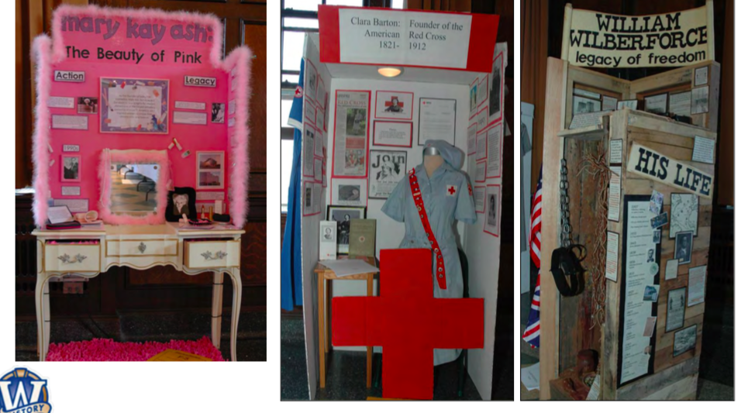

Slide 16
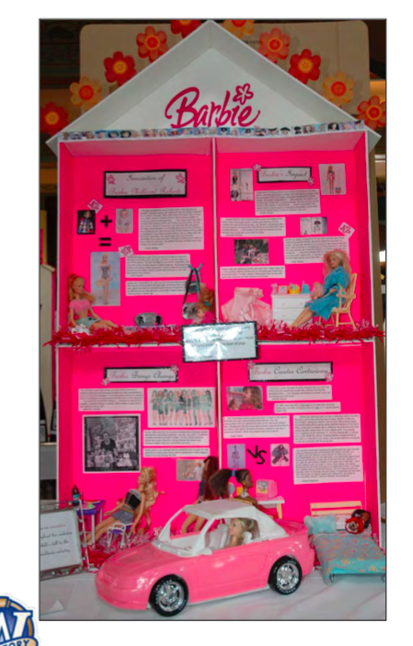

Slide 17
Left Panel
Background/Historical Content
Include
Pictures
Documents
Quotes
Include
What caused the topic/ “setting the scene”
Was there events that caused your topic
Was there a catalysis

Slide 18
Middle Panel
Title- should be put at the top of the board or on a separate piece that fits on top
Must be centered
Not extending to side panels
Large font MUST BE USED
Thesis
Must clear
Include the theme words

Slide 19
Middle Panel
What is your topic
Explain your topic to me as if I don’t know what it is
Don’t us “my topic is” to start your sentence
No first person
What time period did it occur
Give specific time periods
5 specific points/actions to explain your topic
Quotes
Primary Document
Pictures

Slide 20
Right Panel
Immediate Impact
Use your 5 specific examples
Remember immediate impact is during the topic’s time period
Effect Contemporary People
What people thought
Quotes
Pictures of people
Who supported
Who opposed
Give specific examples and reasons

Slide 21
Area In Front of the Board
Interactive timeline of your topic
You must have 10-15 events
Do not put birthday or when they died

Slide 22
Checklist
Meets size requirements
No larger than 40 inches wide, 30 inches deep, and 6 feet high
Or if the exhibit is circular or rotating it is no more than 30 inches in diameter
Theme words used throughout
All pictures, graphs, illustrations, documents, visuals, etc. must include borders and must be labeled
Title and thesis should be properly displayed
A maximus of 500 original words can be on the exhibit
A minimum of 25 visuals display. Remember a minimum of 10 primary sources is required
NOTHING CAN BE HAND WRITTEN
Color coordinate
No empty spaces! Use the whole board
No Personal Pronouns
No simple sentences

